Slide 1
13 September 2016
Ensuring the uptake of science in DRM policy formulation and implementation.

Slide 2
Disaster risk: a growing problem
13 September 2016
Why?
  2005-2015 Globally
    700,000 deaths
    1.4 million injured
    23 million homeless
    1.5 billion affected
    € 1.2 trillion economic losses
    2005
    2015
  Exposure is growing
    Interconnected economy
    Population growth
    Urbanisation
    2005-2015 EU
    80,000 deaths
    € 95 billion economic losses

Slide 3
13 September 2016
Why?
Challenges in the Use of Science in DRM
3 types of needs
Science needs testing to
allow further developments
and transfer
Networks are fragmented:
Silos and Overlapping initiatives
Knowledge is fragmented: Research results are not exploited. Science doesn’t reach policy and operations

Slide 4

13 September 2016
Why DRMKC?
Disaster risk knowledge: policy context
  Union Civil Protection Mechanism
    Article 5.1(a)
      “Improve the knowledge base on disaster risks and facilitate the sharing of knowledge, best practices and information, including among Member States that share common risks”
  Sendai Framework for Disaster Risk Reduction
    2015-2030
    Call for stronger role of science and building risk knowledge

Slide 5
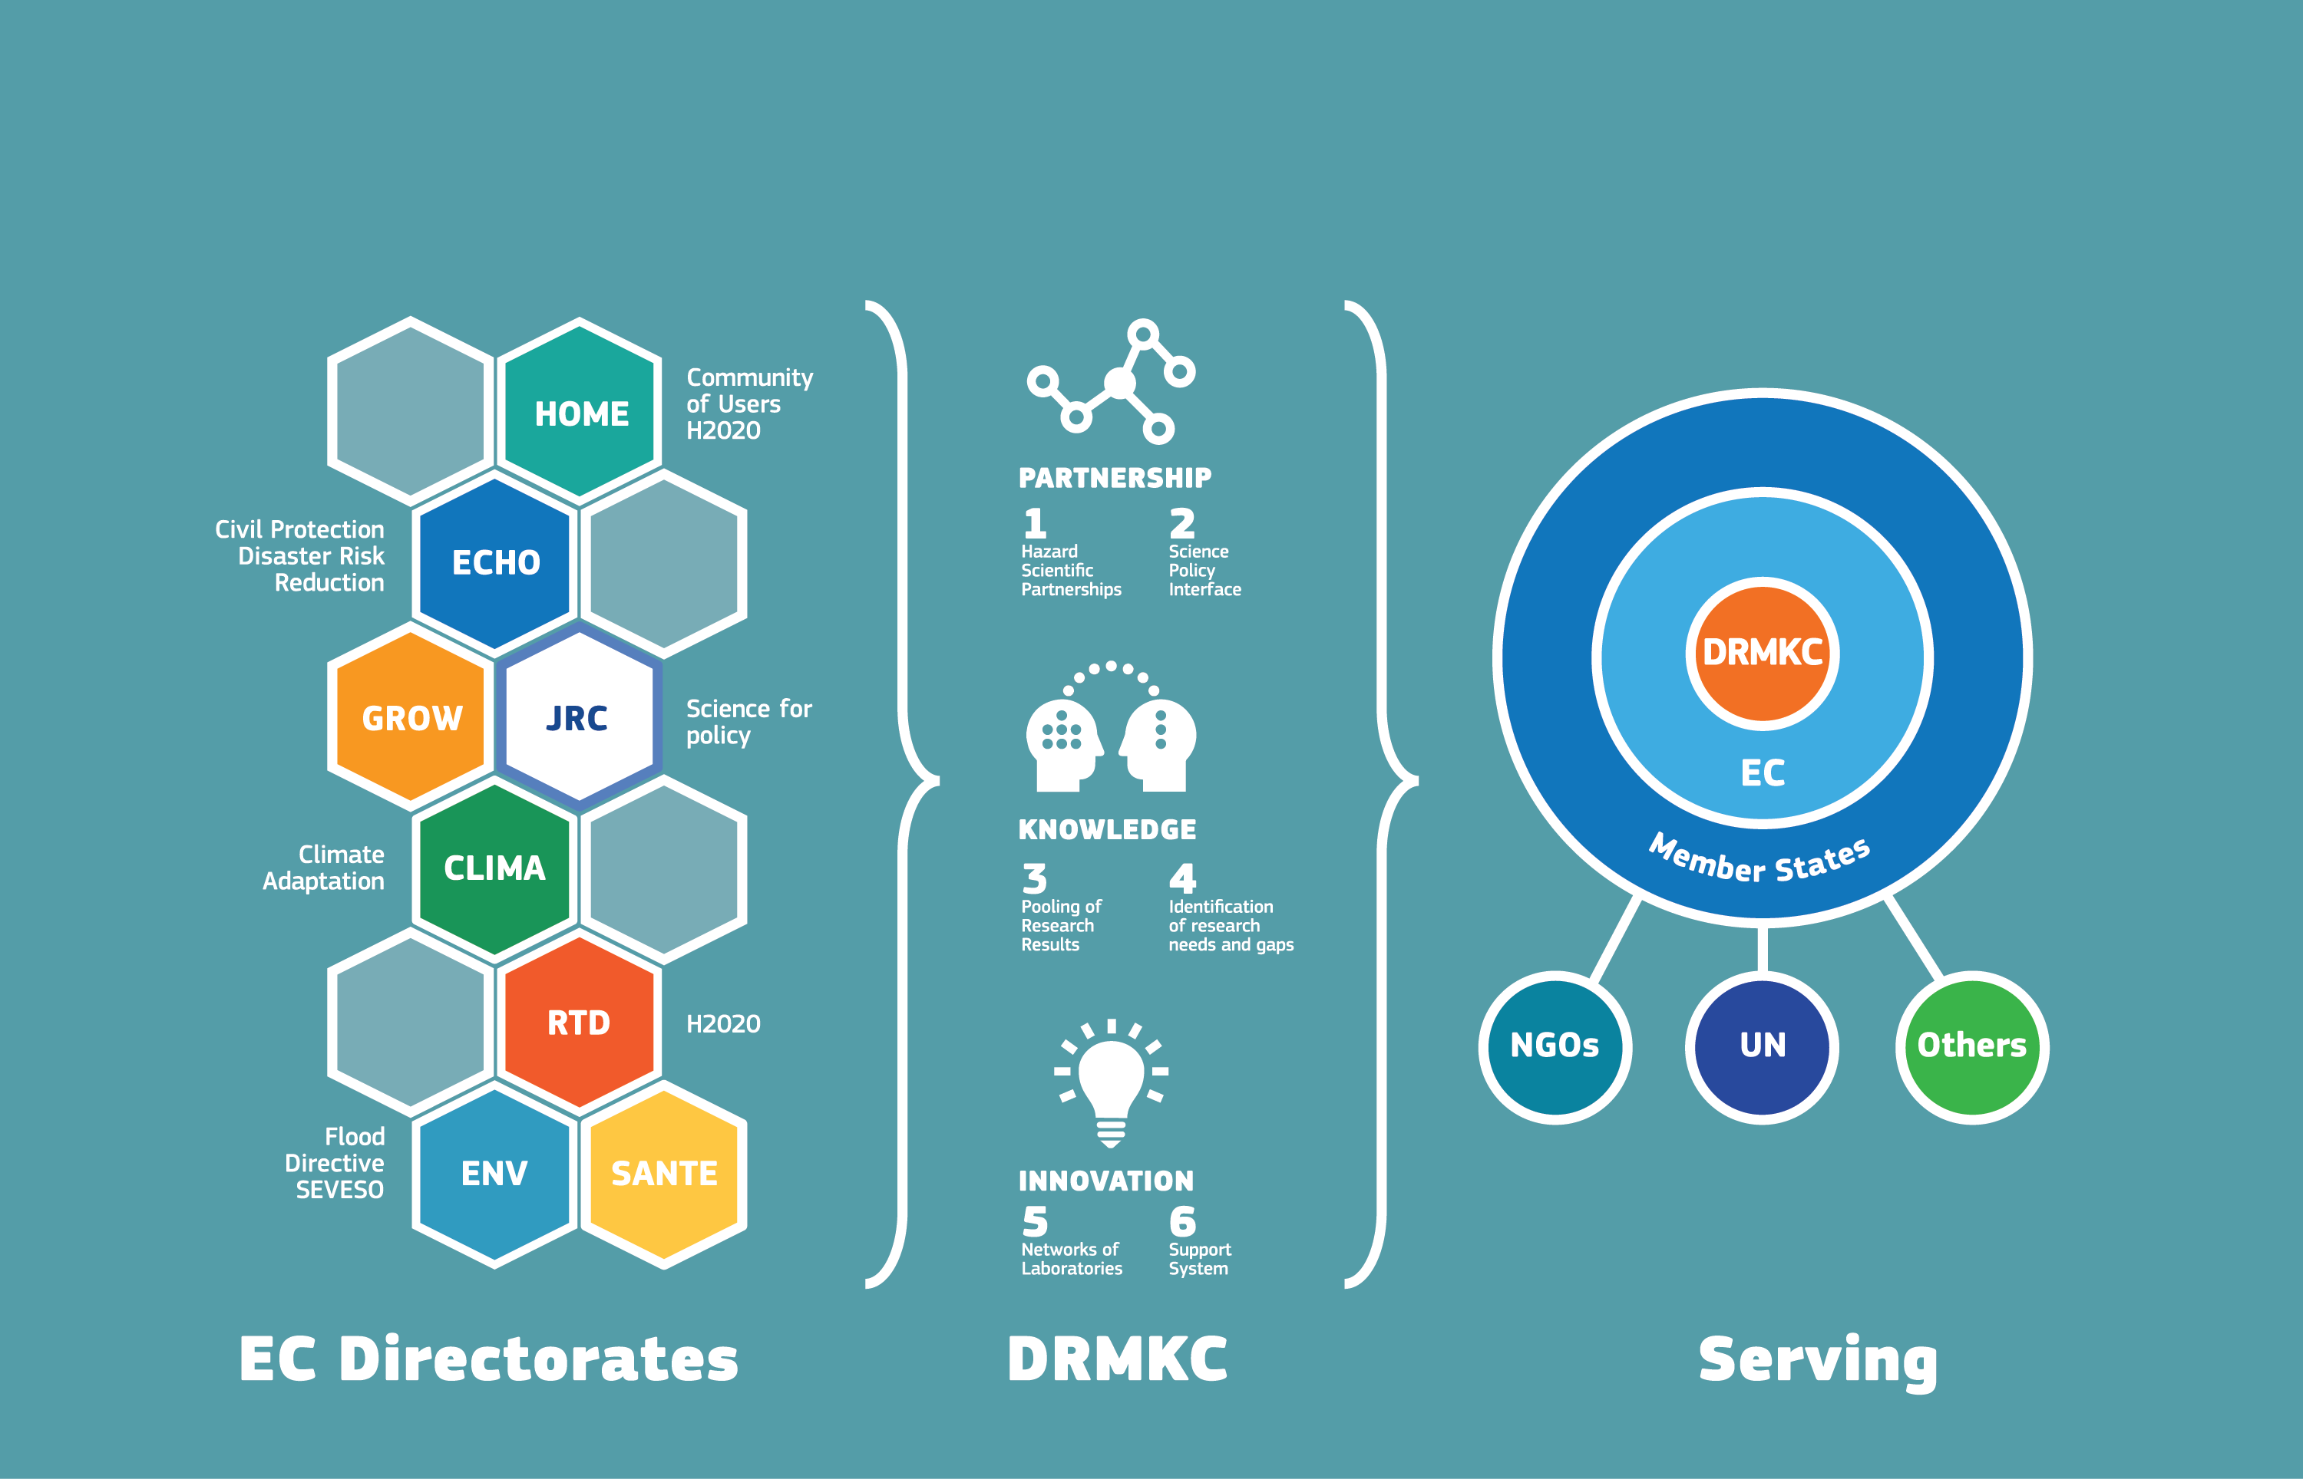
13 September 2016
Why DRMKC?
Notes:
Challenges for using science from point of view of EC services and Member States
“Science is everywhere”
United Nations: Sendai framework, SDG, Climate summit, Humanitarian Summit
European Commission: ECHO, CLIMA, ENV, JRC, RTD, HOME
Expert forums: OECD, Nordic cooperation
Private sector: insurance, reinsurance, public-private partnerships

Slide 6
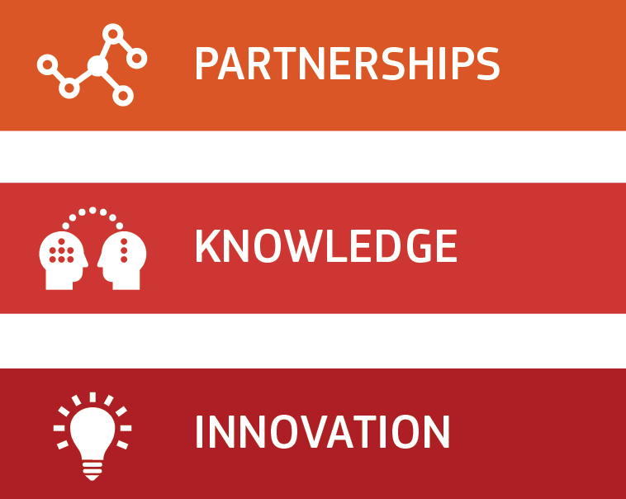
13 September 2016
What?
DRMKC 3 key pillars
Improving
science-based advice through networks and partnerships
Improving the
use and uptake
of research and operational knowledge
Advancing technologies and capacities in disaster risk and crisis management

Slide 7
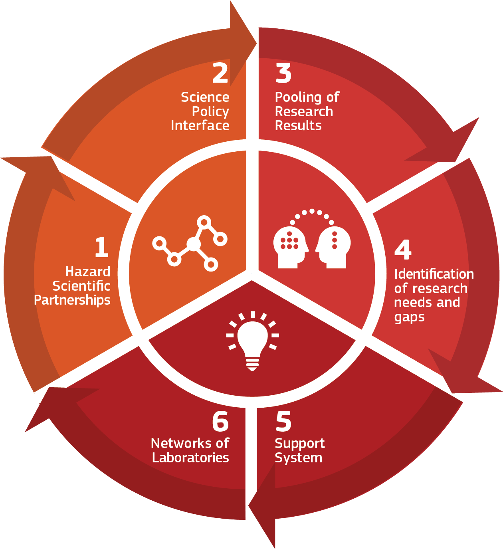
13 September 2016
What?
Action Plan - 6 Objectives

Slide 8
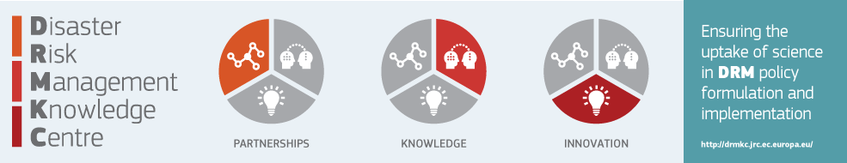
13 September 2016
How?
1. Hazard Scientific Partnerships
  24/7 situation awareness at EU level
  Coherent science-based advice
  From MS to MS and EU
  Impact-based early warning
  EU and global operations
Examples
  Aristotle Project
  EFAS (Floods), EFFIS (Fires) – Copernicus
  Global Informal Tsunami Monitoring System
  Global Flood Partnership
  Global Disaster Alert and Coordination System

Slide 9
13 September 2016
How?
2. Science-policy interface
  Networks of networks
  Coherent science-based advice for policy
  Disaster risk
  EU (UCPM) and global (Sendai)
  Multi-sectorial, across policies (climate change, flood directive, solidarity fund, INSPIRE, SEVESO…)
  Examples
  Sendai targets and indicators: drawing from many networks in EU (deadline 30/11)
  National Risk Assessment
  Disaster Risk Capacities Assessment
  Loss and Damage Data WG
  Disaster Prevention Expert Group
  INFORM Index for Risk Management

Slide 10
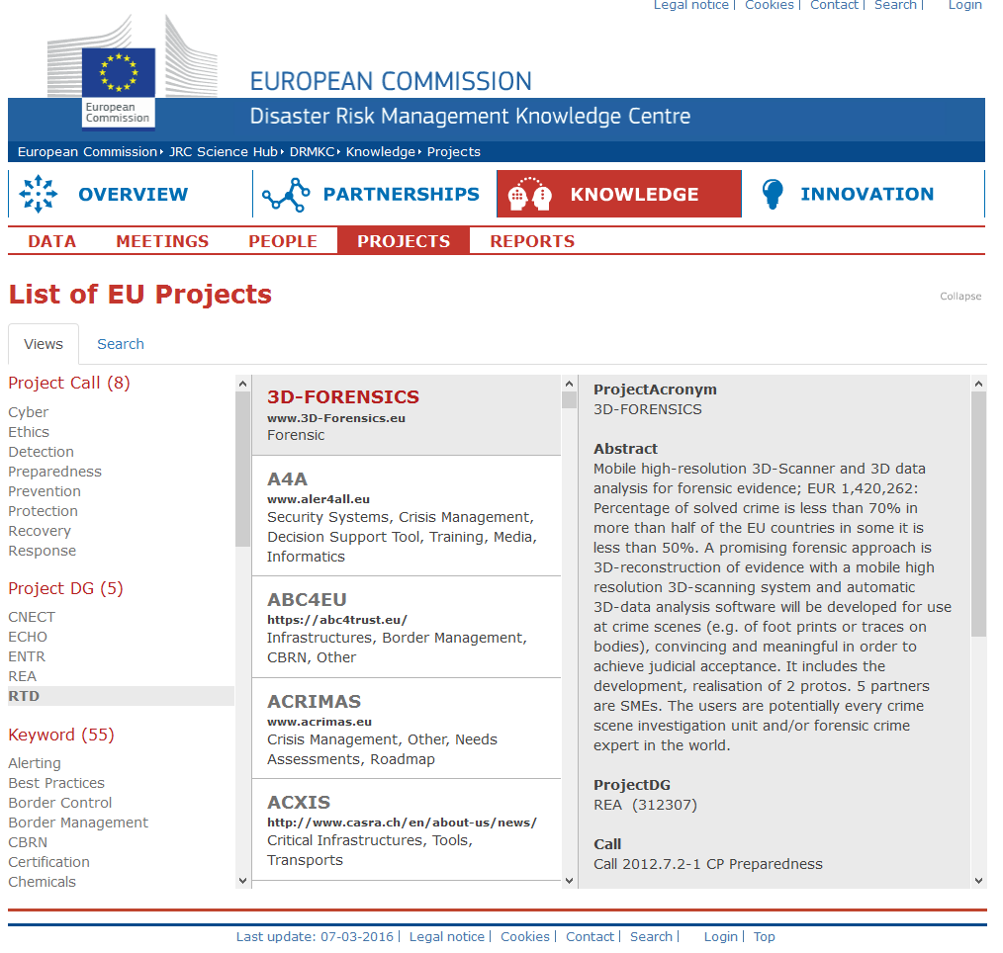
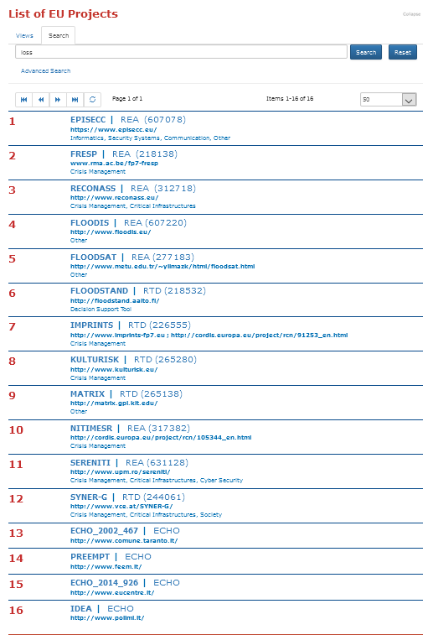
13 September 2016
How?
3. Pooling of research results

Slide 11
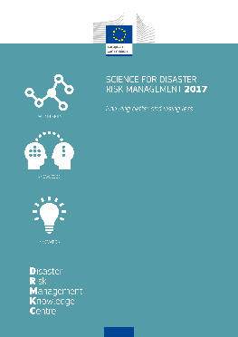
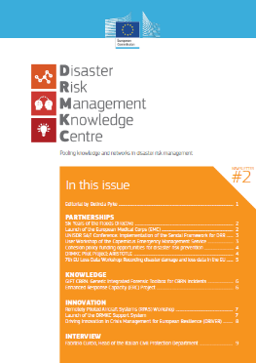
13 September 2016
How?
4. Identification of needs, gaps and dissemination
  Systematic analysis of research needs
  and gaps
  Analysis of state of science
  Dissemination
  Topical Newsletters
  State of Science in Disaster Risk Management (bi-annual)
  In practice
    First report in 2017
    JRC: editorial team
    Lead chapter authors, author teams: call for authors

Slide 12
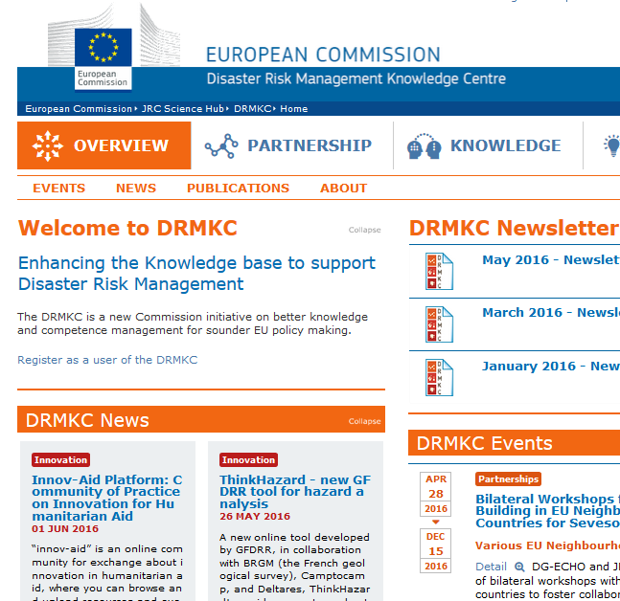
13 September 2016
How?
Dissemination of Information: DRMKC Website
13 September 2016

Slide 13
13 September 2016
How?
5. Risk Management Support System
  Share best practices among MS
  Facilitate the use of existing expertise for meeting risk management obligations
  Topical Newsletters
  State of Science in Disaster Risk Management (bi-annual)
  In practice
  MS identifies need
  Project outline developed together with JRC
  Appropriate expertise is found
  Project is executed
  (Around 10-15 projects in 2016)

Slide 14
13 September 2016
How?
5. Risk Management Support System
Risk Assessment
Disaster Loss Data
Risk Management Capability assessment
Science-Policy Interface
Early Warning
  Share best practices among MS

Slide 15
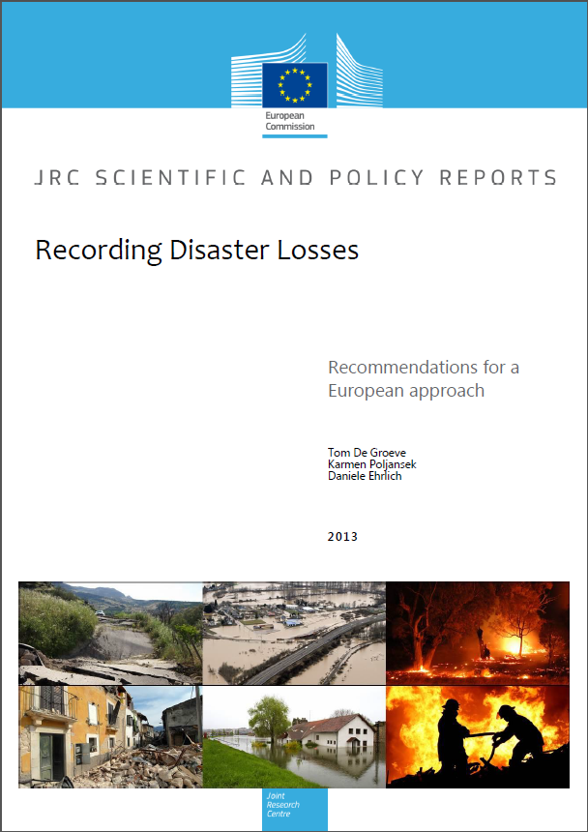
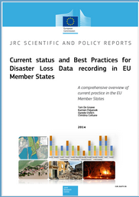
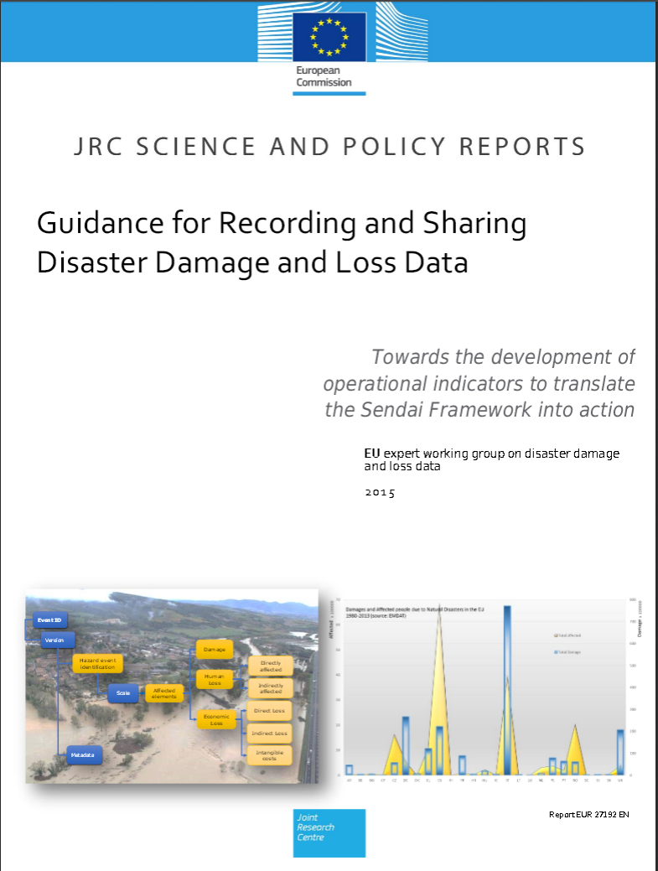
EU DISASTER LOSS DATABASE
13 September 2016
How?
The roadmap for harmonized loss data.
Three key documents prepared in consultation with member states
Recording Disaster losses (July 2013)
Current status and best practices (November 2014)
Guidance for disaster loss data recording (April 2015)

Slide 16
13 September 2016
How?
6. Network of Crisis Management Labs
  Test crisis management technology and practices
    Experimental approach
    Test market ready solutions
    Identify needs for further research, industrial
    development, or training/awareness
  Examples
    JRC European Crisis Management Laboratory:
    7 experiments
    GDACS Crisis Centre Interoperability Benchmarks

Slide 17
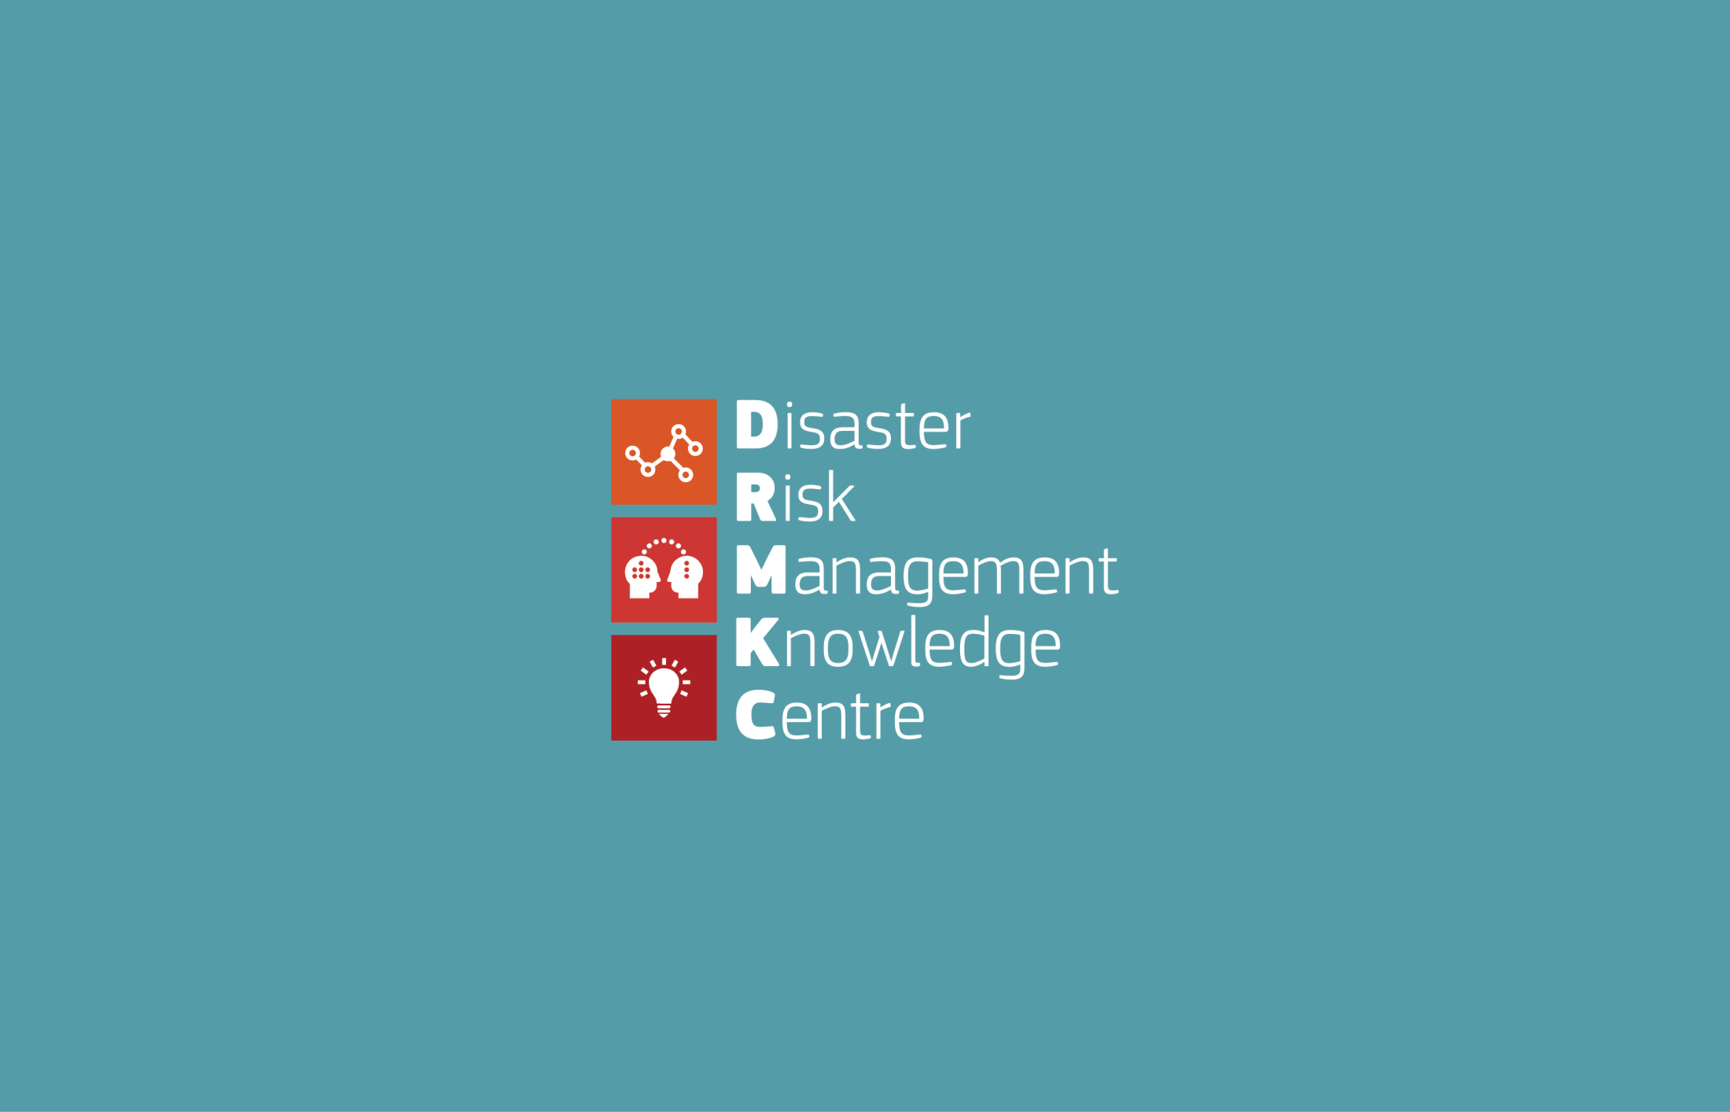
13 September 2016
http://drmkc.jrc.ec.europa.eu/
http://drr.jrc.ec.europa.eu/Loss-Data

